Slide 1
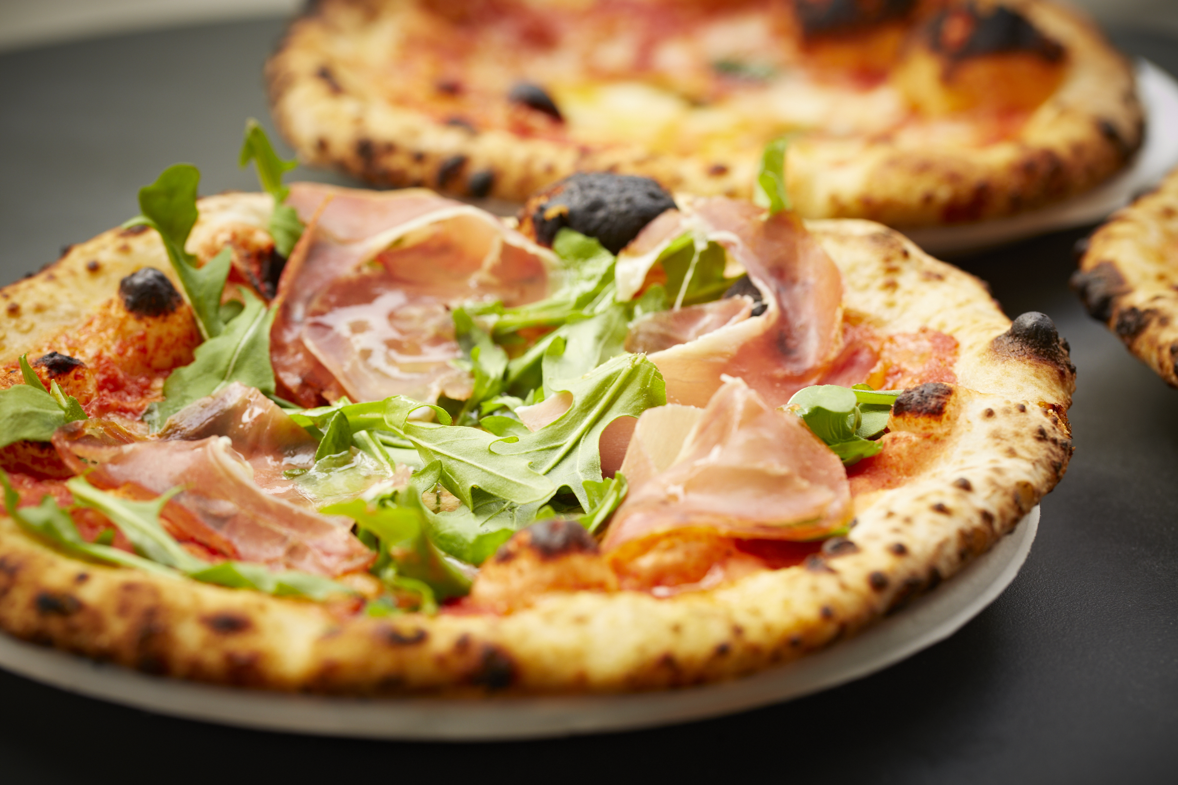
SAM’S PIZZA

Slide 2

Sam’s Pizza has approached us to help understand their product pricings better.
A small dataset has been provided to assist in analysing price elasticity and sales for the company’s best products.
Using the insights and analysis generated, Sam’s Pizza will be able to understand and optimise their pricing to help grow their business positively.

Slide 3

A quick summary of the data provided…

Slide 4
This Dataset Represents…
Around 670 units of pizzas
A Sale Total of $7,178
Total GP$ Calculated at $3,315
Total GP$ Calculated at $3,315

Slide 5
Relationship between Price & Quantity Sold

Slide 6
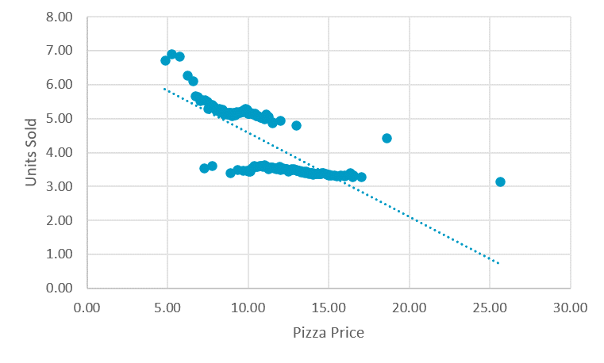
Price VS Sales
Product 1
Product 2
Summary
Price Elasticity measures how sensitive the quantity demanded or supplied of a good or service is to changes in its price.
Sam’s Pizza experiences a drop in sales when the prices increase. This is an example of elastic demand.

Slide 7
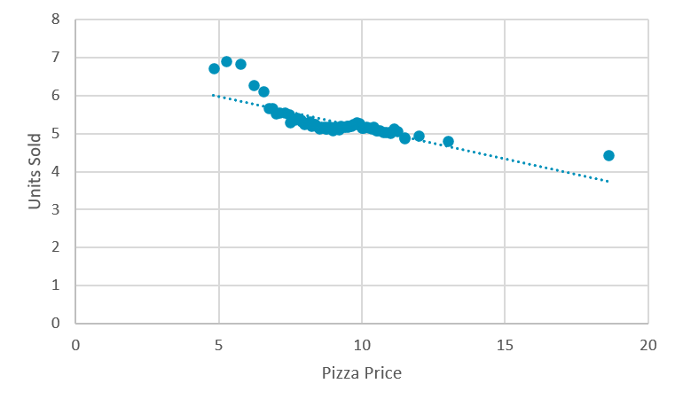
Price VS Sales
Product 1
Product 2
Summary
Each product will be different to some degree.
Product 1 appears to show minor elasticity.

Slide 8
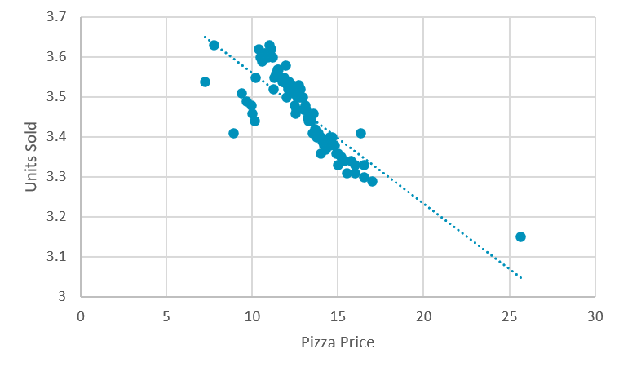
Price VS Sales
Product 1
Product 2
Summary
Product 2 appears more price elastic.
There is a larger change in quantity sold as a result of price changes.

Slide 9

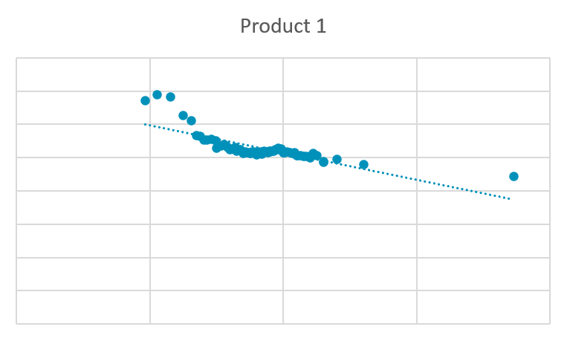
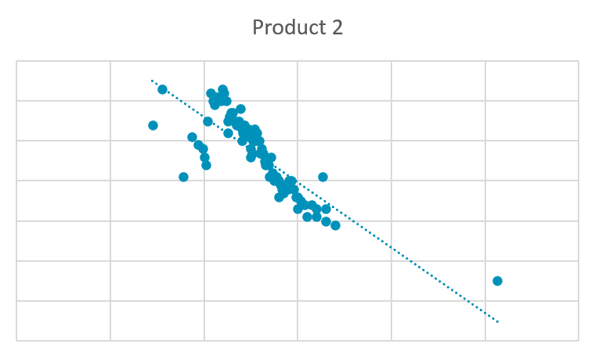
Price VS Sales
Product 1
Product 2
Summary
With the two products side by side, you can see exactly how Product 2s’ customers react to a price change compared to Product 1.
Product 2 is the more elastic of the group.
As product 2 is purchased less than product 1, this may cause larger swings in results.

Slide 10
Now we know how sensitive customers are for each product, let’s look at what potential pricing can look like.
1
Customers: What is their purchase behaviour?
How price sensitive are they?
Are they consistent?
Sam’s goal is to maximise gross profit.
What should we consider when adjusting the price?
2
Competitors: Who are the competitors?
What are they doing?
What’s in market?
3
Promotional Activity

Slide 11
Important to know:
Price Elasticity of Demand is calculated using the following formula
This formula helps us understand how sensitive demand is for the products.
Percentage Change in Quantity Demanded
Price Elasticity of Demand
=
Percentage Change In Price

Slide 12
Looking at Product Prices…

Slide 13
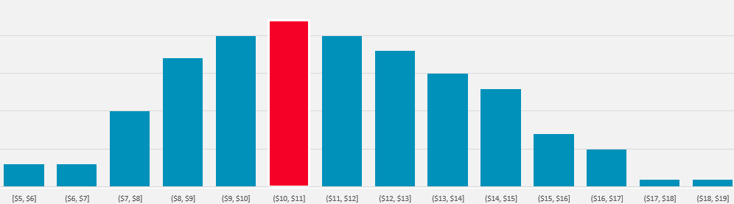
Looking at Product Prices…
Product 1
Price Elasticity of Demand: -3.60
Avg Price: $9.16
Recommended Price: $10.00
Increase to Avg Price: +9.17%
Decrease to Demand: -33.5%

Slide 14
Looking at Product Prices…
Product 1
Price Elasticity of Demand: -3.60
Avg Price: $9.16
Recommended Price: $10.00
Increase to Avg Price: +9.17%
Decrease to Demand: -33.5%

Slide 15
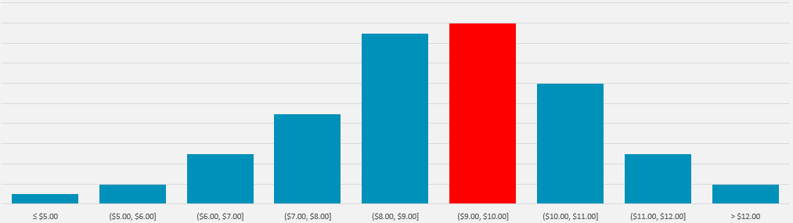
Looking at Product Prices…
Product 2
Price Elasticity of Demand: -12.55
Avg Price: $12.89
Recommended Price: $13.00
Increase to Avg Price: -0.01%
Decrease to Demand: -11.5%

Slide 16
Looking at Product Prices…
Product 2
Price Elasticity of Demand: -12.55
Avg Price: $12.89
Recommended Price: $13.00
Increase to Avg Price: -0.01%
Decrease to Demand: -11.5%

Slide 17
Product 1
- % Overall Sales Units = 56.04
GP% = 47.25%
Cost% = 52.75%
This product costs less and makes more.
Increasing price less risky.
Price increases are flexible.
Product 2
-%Overall Sales Units = 43.96%
-GP = 45.24%
-Cost% = 54.76
This product costs more and makes less.
Increasing price risky.
Avoid lowering price.

Slide 18
Future Analysis
Time Series & Seasonality
Average Transaction Value
Units Per Transaction
Promotion Efficacy
Customer Loyalty & Retention

